Slide 1



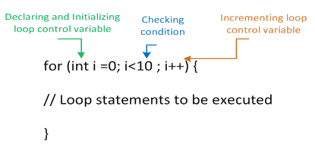


Zero Trust Core Principles
Verify explicitly: identity, device, location, behavior, risk.
Least privilege: JIT/JEA, role- and attribute-based access.
Assume breach: segment, egress control, encrypt everywhere.
Continuous evaluation: every request/session, not one-time login.
Policy-as-code: versioned, tested, automated enforcement.
Telemetry-driven: measure, learn, adapt in near real time.

